Slide 1


Social Networking Site
Submitted by: Mahaan Lal Srivastav
Submission type : Individual
Name: Social Networking Site
Batch : AXIS SFT 12
LMS Id : srilalmahaan@gmail.com
Program : Axis Fintech
Date: 01/06/2023
Git-Hub Link: https://github.com/mahaansrivastav/social-networking-site

Slide 2


Table of contents
Introduction
Project Overview
Architecture Design
User Interface Design
Back-end Development
Front-end Development
Conclusion
Future Work
References
End

Slide 3

Introduction
Introducing our social networking site that revolutionizes social connectivity. With a focus on meaningful connections and a seamless user experience, our site offers exciting features such as personalized user profiles, easy search and discovery, a curated news feed, secure messaging and chat, interest-based groups, and robust privacy and security measures.
Connect, share, and build relationships in a whole new way.

Slide 4

Project Overview
Our social networking site revolutionizes social connectivity, focusing on meaningful connections and seamless experiences.
Key features:
User Profiles: Showcase your identity, interests, and activities, enabling others to know you better.
Search and Discover: Find friends and like-minded individuals effortlessly.
News Feed: Stay updated with curated posts, photos, and activities from your network.
Messaging and Chat: Enjoy private conversations through our secure messaging system.
Privacy and Security: Robust measures safeguard your personal information, granting you control over privacy settings.

Slide 5
Architecture Design
Front-end: Our social networking site boasts a responsive design that seamlessly adapts to various devices, ensuring optimal user experience.
Back-end: The back-end of our platform comprises servers that handle crucial tasks such as data processing, logic implementation, and storage. RESTful APIs facilitate seamless communication between the front-end and back-end systems. User authentication, message routing, notifications, and other essential functionalities are efficiently managed by the back-end.
Database: Our application leverages a robust database system to store and manage user profiles, chat history, and other pertinent data. The database is meticulously structured with well-defined tables, schemas, and relationships, ensuring efficient data management and retrieval.

Slide 6
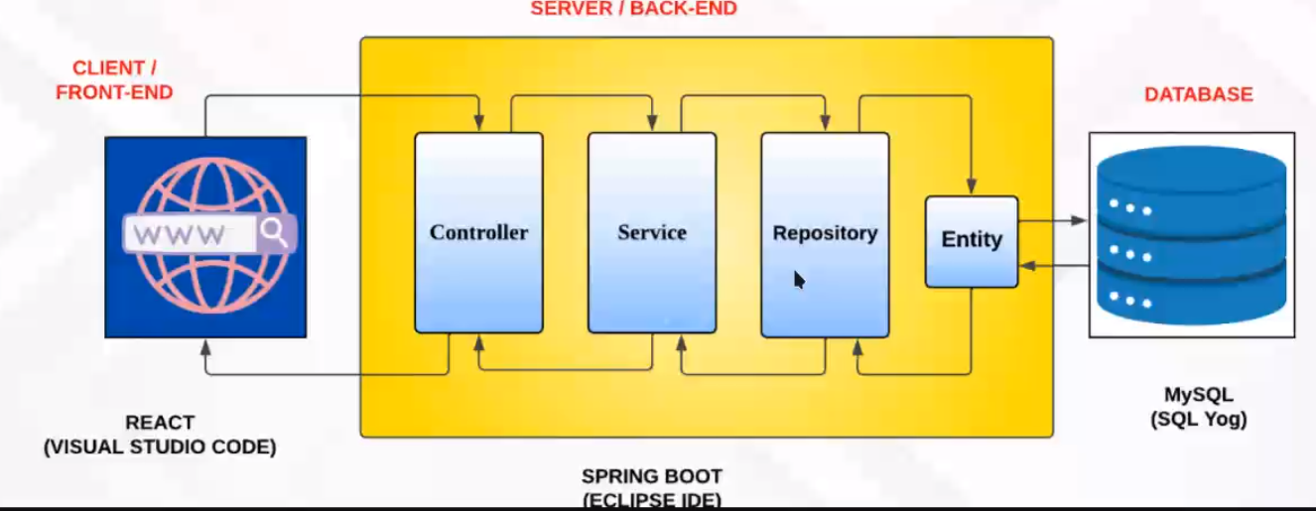


Architecture Design

Slide 7
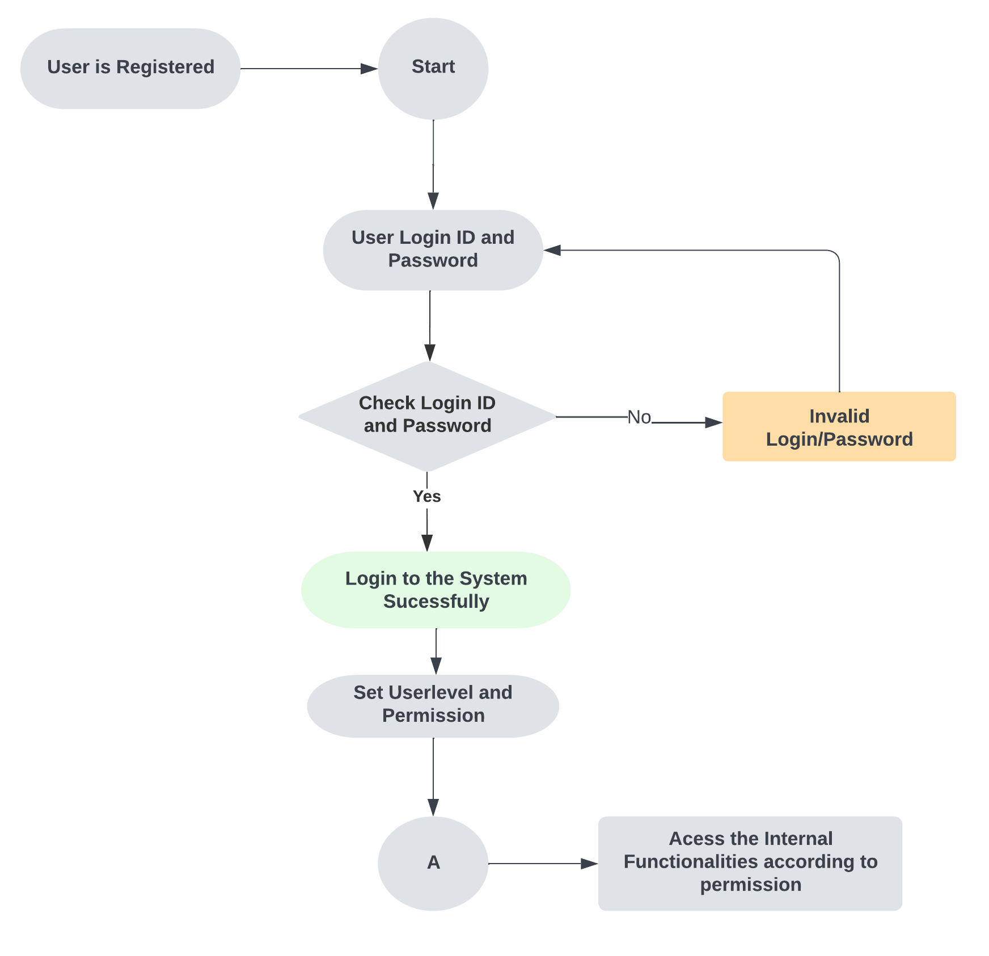
Architecture Design

Slide 8
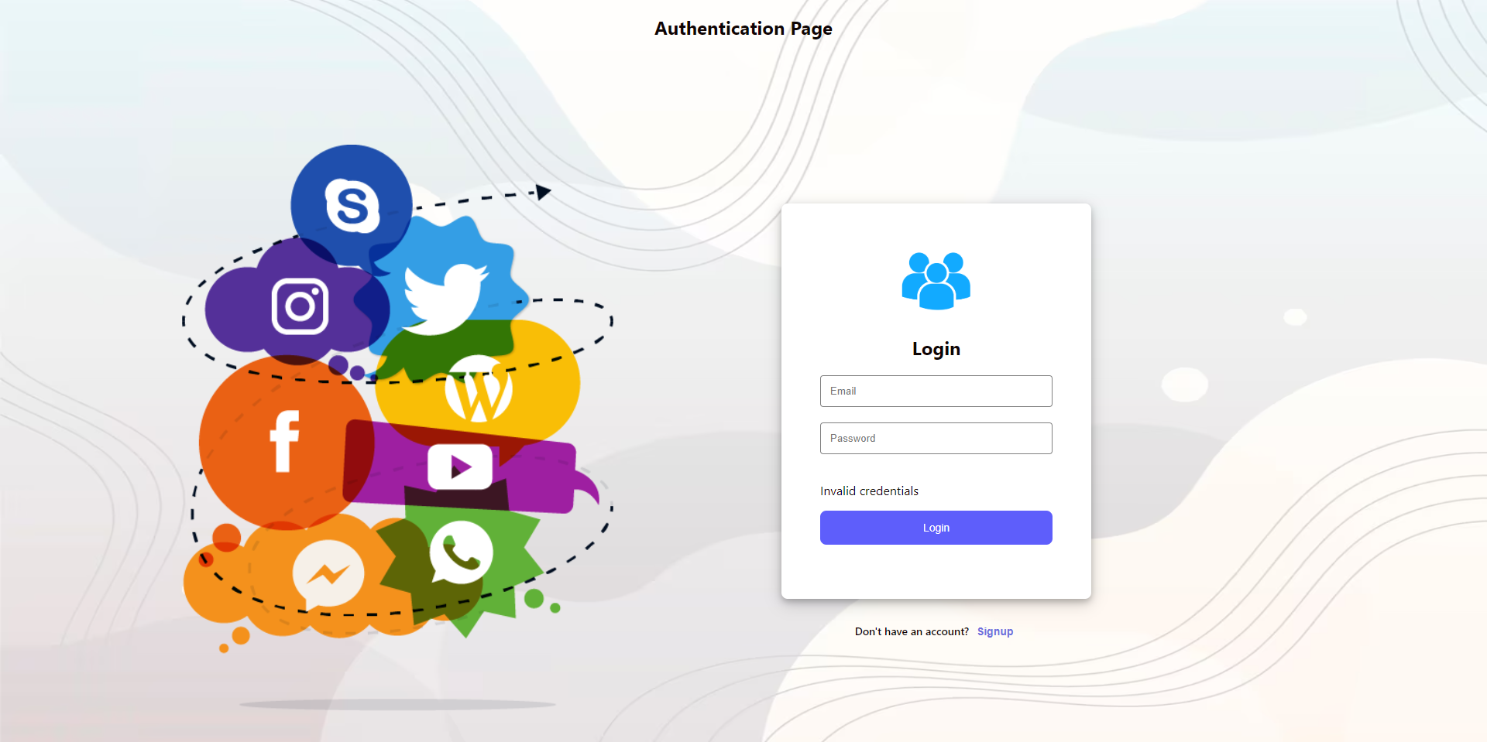
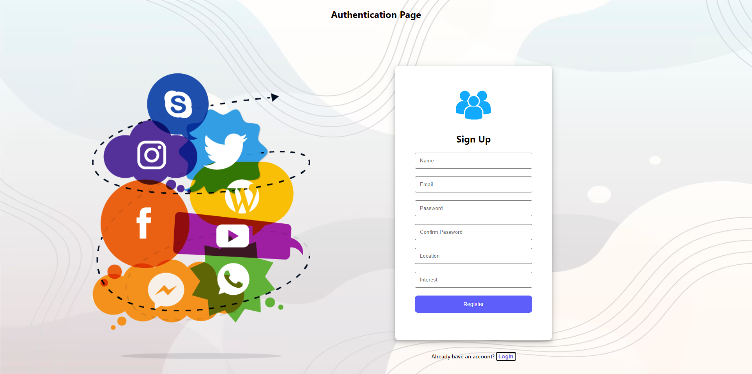
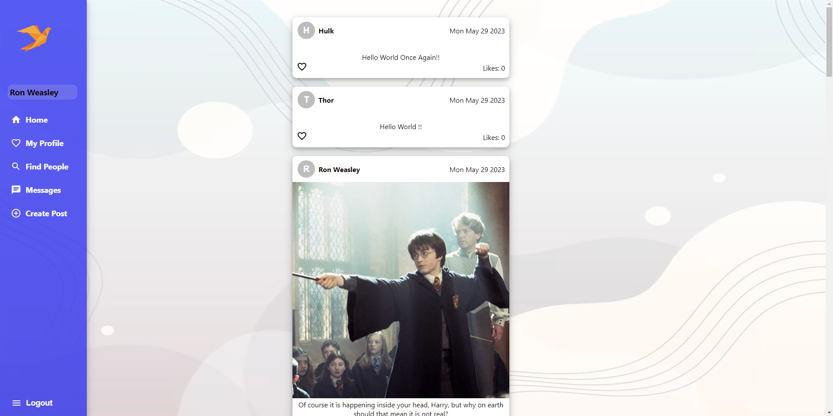
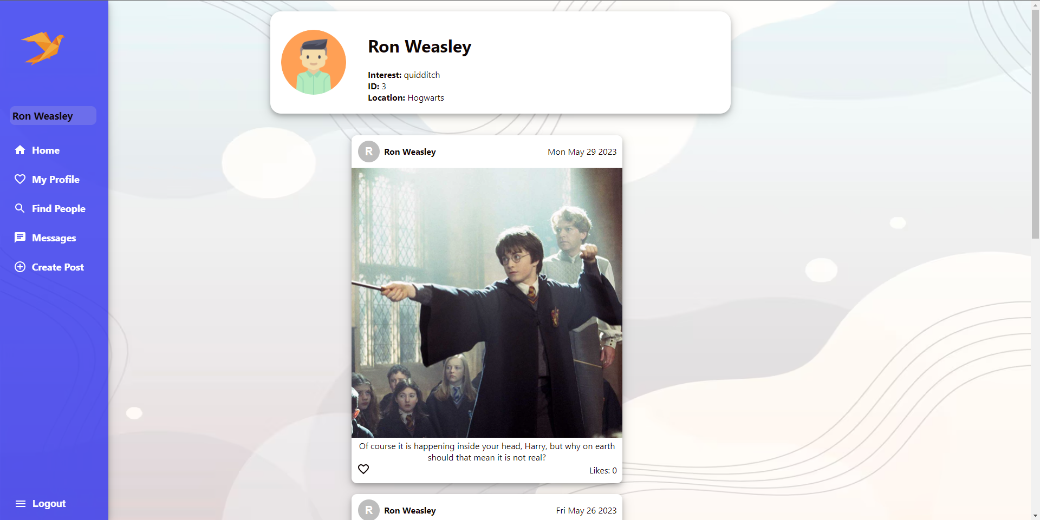
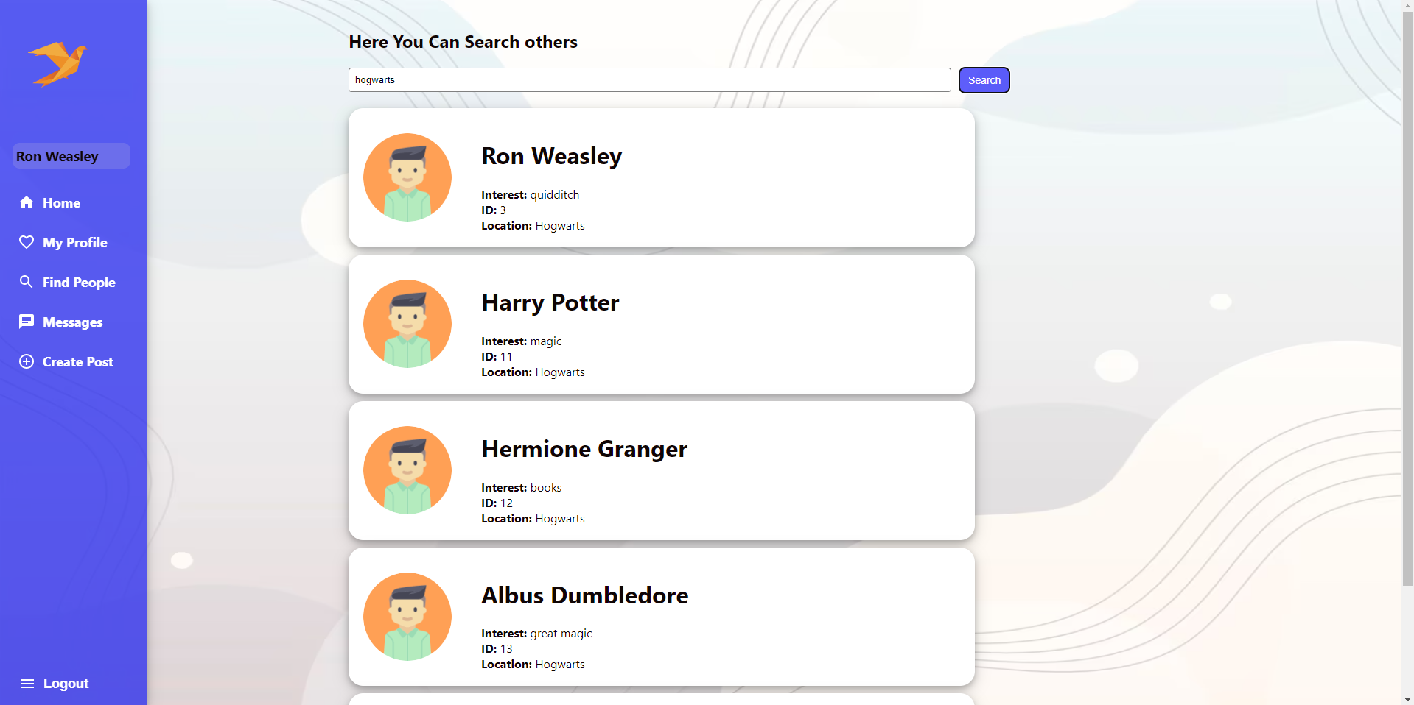
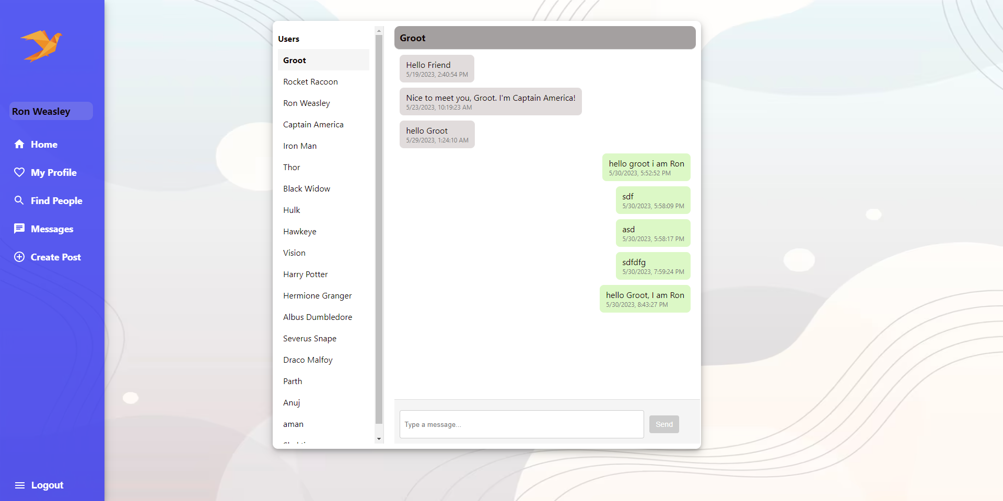
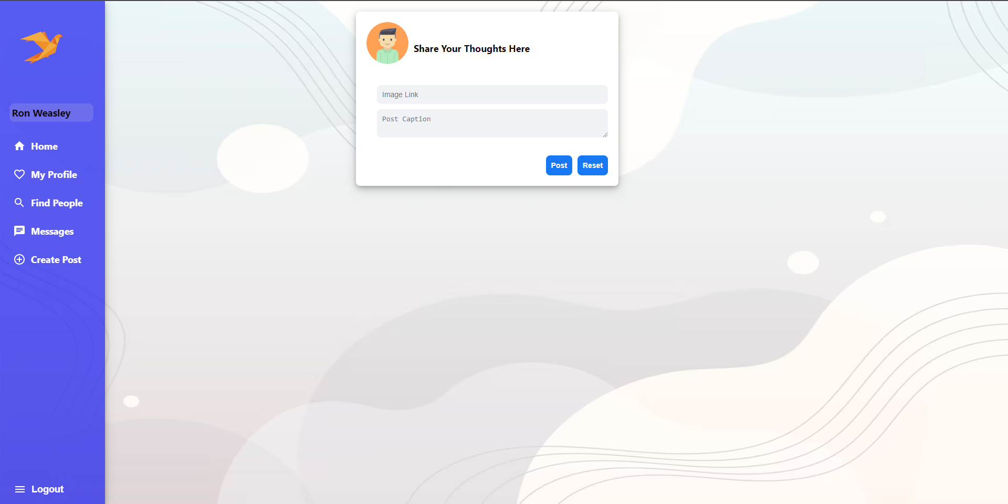
User Interface Design
This section explains the design of the user interface, including wireframes, mockups, and user flows.

Slide 9



Back-end Development
Spring Boot: A Java framework that streamlines the development of high-quality Spring applications by offering simplified setup, configuration, and built-in features for building robust backend systems.
Hibernate: A Java-based ORM framework that facilitates seamless interaction between Java objects and databases, abstracting the complexity of SQL queries and providing a convenient mapping mechanism.
Dependencies: Essential components required for the project's functionality, including Spring Devtools for development efficiency, Spring Web for web-based features, MySQL Driver for connecting to the MySQL database, Lombok for reducing boilerplate code, and JPA for managing the persistence layer.

Slide 10
Back-end Development
Directory Structure
Entity | Repository | Service Layer | Controller
User | UserRepository | UserService | UserController
Messages | MessagesRepository | MessagesService | MessagesController
Group | GroupRepository | GroupService | GroupController
Friends | FriendsRepository | FriendsService | FriendsController
Messages | MessagesRepository | MessagesService | MessagesController
Post | PostRepository | PostService | PostController

Slide 11
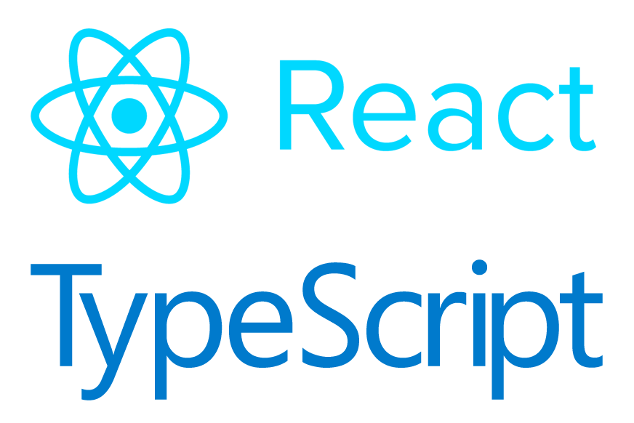
Front-end Development
React: Powering Immersive User Experience of a single page application
JavaScript: Enhancing Functionality and Interactivity
Axios: Efficient Backend Communication
CSS for beautifying User Interface

Slide 12

Integration and Testing
Postman
Our API underwent thorough testing using Postman, validating functionality, performance, and security of endpoints. Postman's intuitive interface efficiently tested various API requests (GET, POST, PUT, DELETE), providing a robust environment to simulate real-world scenarios and assess API response.

Slide 13
Conclusion
Social Networking Site is a full stack web application implemented by using Spring boot in Back-end and React in Frontend and mySQL is used for database.
It has some main functionalities:
Login/Logout and
Create Account
Create Post
User can visit his/her profile page
Like other posts
Search other users using their location, interest, email
Chat with other users

Slide 14

Future Work
Following Features can be implemented in our project in future:
Comments
Visiting other people profile
Groups Activities
Adding Friends
Date of Birth Validation
Implementing Security Features
Updating user details
Deleting user account
Deployment of the project

Slide 15

References
Spring Boot Reference Documentation
https://docs.spring.io/spring-boot/docs/current/reference/htmlsingle/
React Js official Documentation
https://legacy.reactjs.org/docs/create-a-new-react-app.html
CSS References
https://developer.mozilla.org/en-US/docs/Web/CSS/Reference
JavaScript reference
https://developer.mozilla.org/en-US/docs/Web/JavaScript/Reference
Java official Documentation
https://docs.oracle.com/javase/8/docs/

Slide 16


